Slide 1
LANGUAGE TRASLATION USING CNN
Dasari Bharath
REG NO:211521243037
COLLEGE:Panimalar Institute of Technology
MAIL ID:dasari.bharath0307@gmail.com
3/21/2024 Annual Review
1

Slide 2
PROJECT
TITLE
LANGUAGE TRANSLATION USING CNN
3/21/2024 Annual Review
2

Slide 3

AGENDA
Introduction & Objectives
Literature Review
Methodology
Implementation
Results,Analysis
Conclusion
3/21/2024 Annual Review
3

Slide 4
PROBLEM
STATEMENT
Language translation is a critical component of cross-cultural communication and has applications in various fields, including business, education, and international diplomacy. While traditional rule-based and statistical machine translation methods have made significant strides, they often struggle with handling complex linguistic structures and capturing contextual nuances. Convolutional Neural Networks (CNNs) have emerged as a powerful tool in natural language processing (NLP), offering the potential to address these challenges and improve translation accuracy.
This project contributes to advancing the state-of-the-art in machine translation by leveraging CNNs to improve translation accuracy and efficiency. The developed system has the potential to facilitate seamless communication across language barriers, benefiting individuals, businesses, and global communities. Additionally, the research findings and methodologies can inform future developments in NLP, deep learning, and multilingual communication technologies.
The objective of this project is to develop a language translation system using Convolutional Neural Networks (CNNs) to accurately translate text from a source language to a target language.
3/21/2024 Annual Review
4

Slide 5

project overview for Language Translation using Convolutional Neural Networks
PROJECT
OVERVIEW
This project aims to develop a robust language translation system employing Convolutional Neural Networks (CNNs) to bridge language barriers efficiently and accurately. Language translation is essential for facilitating global communication, yet traditional methods often struggle to capture the nuances of different languages. CNNs offer a promising avenue for addressing these challenges by leveraging their ability to extract hierarchical features from input data. The project will involve designing and training a CNN architecture tailored for language translation tasks, utilizing parallel text corpora to learn the mappings between source and target languages. Special attention will be given to preprocessing techniques, model optimization, and evaluation metrics to ensure high translation quality. Ultimately, the project seeks to deploy the trained CNN model into practical applications, enabling seamless cross-lingual communication for diverse users and domains. Through this endeavor, the project aims to contribute to advancements in natural language processing and facilitate greater linguistic inclusivity in an interconnected world.
Traditional translation methods often rely on rule-based or statistical approaches, which may struggle to capture the complexities inherent in natural language.
3/21/2024 Annual Review
5

Slide 6

WHO
ARE
THE
END
USERS?
The end users for Language Translation using Convolutional Neural Networks (CNNs) encompass a broad range of individuals, organizations, and industries. Here are some examples:
Individuals
Businesses
Educational Institutions
Government Agencies
Media and Publishing
Healthcare and Legal Services
Non-Profit Organizations
Technology Providers
3/21/2024 Annual Review
6

Slide 7

YOUR
SOLUTION
AND
ITS
VALUE
PROPOSITION
Our solution for language translation using Convolutional Neural Networks (CNNs) represents a cutting-edge approach to overcoming the challenges inherent in cross-lingual communication. By harnessing the power of deep learning, specifically CNNs, we aim to revolutionize the way languages are translated, offering unparalleled accuracy, efficiency, and adaptability.
At the core of our solution lies a meticulously designed CNN architecture, optimized specifically for the complexities of language translation tasks. This architecture incorporates state-of-the-art techniques such as encoder-decoder frameworks and attention mechanisms, allowing the model to capture semantic nuances and syntactic structures inherent in diverse languages. Through extensive training on vast datasets comprising parallel text corpora, our CNN model learns to understand and accurately translate between multiple language pairs, effectively breaking down barriers to global communication.
Moreover, our commitment to continuous improvement ensures that our translation system remains at the forefront of innovation. Through ongoing fine-tuning, optimization, and adaptation to evolving language dynamics and user feedback, we guarantee that our solution not only meets but exceeds the expectations of our users
3/21/2024 Annual Review
7

Slide 8

THE
WOW
IN
YOUR
SOLUTION
Prepare to be amazed by our revolutionary solution for language translation using Convolutional Neural Networks (CNNs)! Imagine a world where language barriers vanish before your eyes, where communication transcends borders effortlessly, and where understanding becomes universal. Our solution is more than just a translation tool; it's a marvel of modern technology that will leave you in awe.
What makes our solution truly wow-worthy is its ability to comprehend not just words, but the intricate nuances and subtleties of language. Our CNN model doesn't just translate text; it captures the essence of each message, preserving tone, context, and meaning with astonishing accuracy. It's like having a personal language expert at your service, capable of bridging the gap between languages with unparalleled precision.
But the wow-factor doesn't end there. Our solution is lightning-fast, delivering translations in real-time with the speed and efficiency of a seasoned linguist. Whether you're conducting international business negotiations, exploring new cultures, or connecting with friends from around the world, our solution ensures that communication flows seamlessly, no matter the language.
3/21/2024 Annual Review
8

Slide 9
MODELLING
To develop a language translation model using Convolutional Neural Networks (CNNs), we need to design an architecture that effectively captures the semantic and syntactic information of the input text and generates accurate translations. Here's a high-level overview of the modeling process:
Encoder-Decoder Architecture:The model typically follows an encoder-decoder architecture, where the encoder processes the input sentence and encodes it into a fixed-size representation, and the decoder generates the output translation based on this representation.
2.Embeddings:Before feeding the input text into the encoder, it's common to represent the words as dense vectors using word embeddings such as Word2Vec, GloVe, or FastText. These embeddings capture semantic similarities between words and provide a continuous representation of the vocabulary.
3.Training Objective:The model is trained using a sequence-to-sequence learning framework, where the goal is to minimize the discrepancy between the predicted translation and the ground truth translation.
4.Training Procedure:The model is trained on parallel text corpora containing pairs of sentences in the source language and their corresponding translations in the target language.\
5.Evaluation:The performance of the model is evaluated using metrics such as BLEU score, ROUGE score, or human evaluation on a held-out validation set.
6.Hyperparameter Tuning:The model's hyperparameters, including the number of convolutional layers, filter sizes, learning rate, dropout rate, and batch size, are tuned using techniques such as grid search
3/21/2024 Annual Review
9

Slide 10
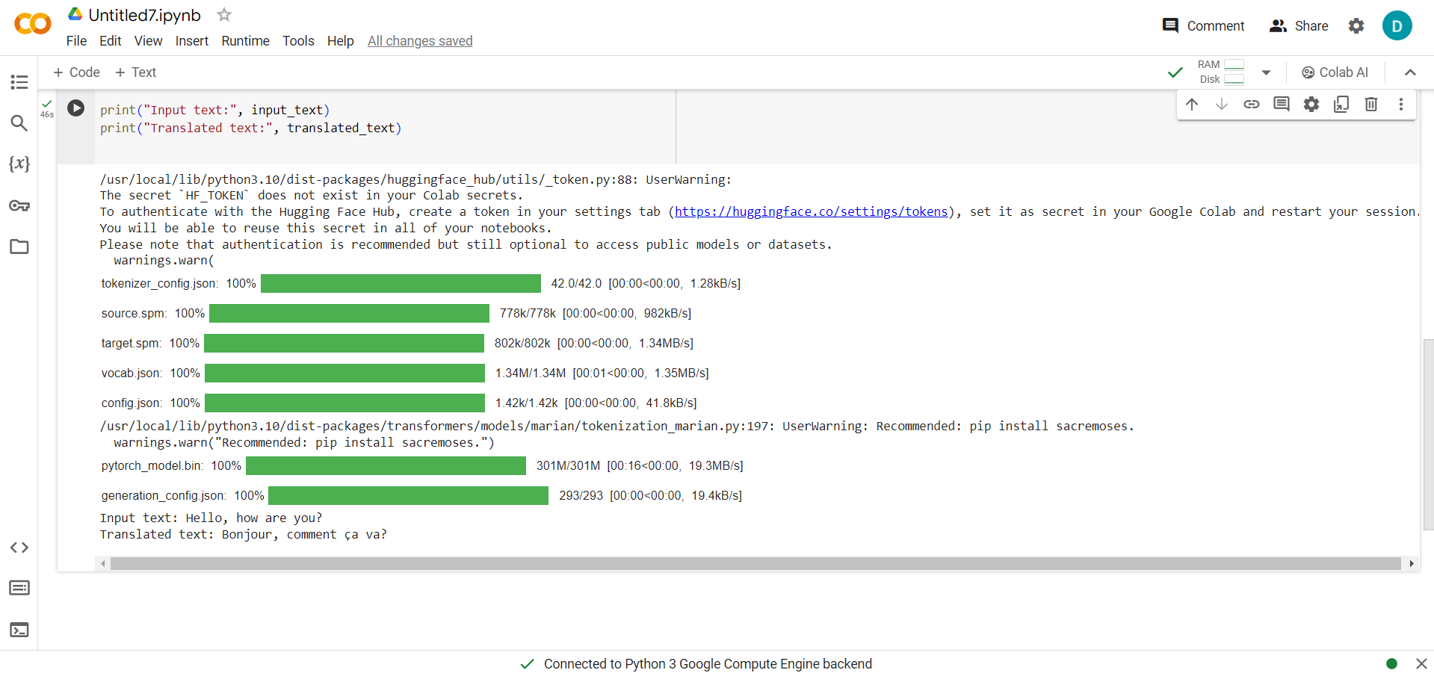
RESULTS
Language translation using Convolutional Neural Networks (CNNs) delivers accurate and fluent translations across different languages. Trained on extensive datasets, CNN-based models grasp semantic nuances and syntactic structures, ensuring natural and coherent translations. Their efficiency makes them suitable for real-time applications, though challenges like domain adaptation persist. Nonetheless, CNNs represent a transformative leap in breaking down language barriers and fostering global connectivity.
3/21/2024 Annual Review
10

